Slide 1
LEGO® Education Academy Teacher Training
LEGO® Education INFORMATION SESSION
Notes:
Welcome Slide
Show this slide as the participants enter the training room.

Slide 2
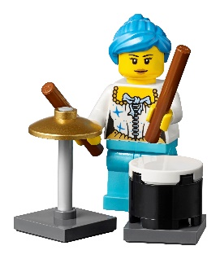
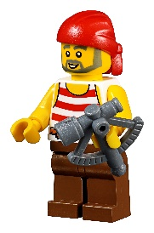
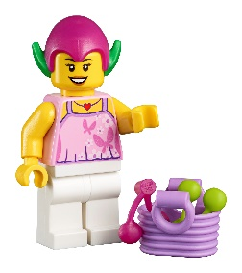
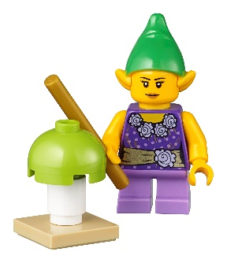
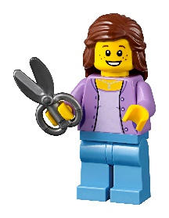
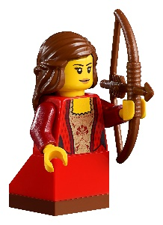
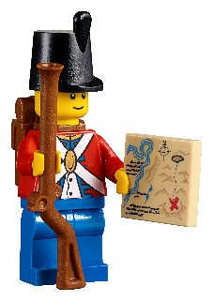
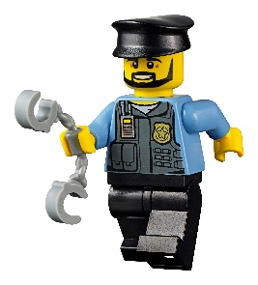
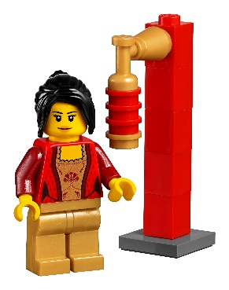
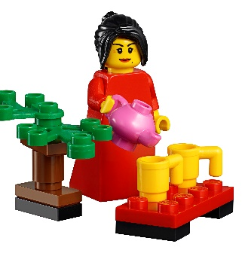
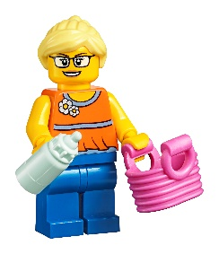
My name is Derek, and I’ll be your trainer today.
Notes:
Introductions
Type your name where you see the “xxx.”
Ask the participants to briefly introduce themselves.
Introduce yourself, briefly telling about your background and why you’re qualified to teach the course.
Remember to say/cover the following points:
Please share a few facts about yourself and why you’re here today. It could be:
A bit about where you work and what you do.
Whether you’ve ever taught with LEGO Education materials before, and if so, how? Please share your experiences.
What you hope to get out of today’s course.
Tips
Keep it very brief.
Especially for larger groups:
Consider presenting the objectives and expectations on the next slide before asking the group for their (additional) objectives and expectations.
Consider using a more structured but fun format. For example:
Subject bricks: Have each participant select bricks of different colors, each representing a subject that they teach, and build a small stack.
Hashtags: Ask each participant which three hashtags would define them if they were a social media post.
Find someone who: Ask the participants to walk around and, before the music you play stops, find as many other participants as possible who
teach a certain subject or the same subject as they do
have (not) used Scratch before
have used LEGO bricks for learning before
…

Slide 3
Objectives and Expectations
Get started with the LEGO® Education approach to learning
Review the kits that you will have access to.
Prepare to teach STEAM following the progression of the Lesson units, and build your students’ confidence
Develop ideas for running and facilitating hands-on lessons
Discuss classroom management tips
Notes:
Objectives and Expectations
Walk through today’s training objectives.
Remember to say/cover the following points:
(When talking about the last bullet…) It’s OK to have fun today. When we’re having fun, we’re motivated. And when we’re motivated, we learn more effectively!
Ask the participants if there’s anything else they expect from the course.
Tips
If the participants mention any additional expectations, write them on the board, sticky notes, or a flip chart.
Talking about objectives and expectations doesn’t necessarily mean that you have to try to cover everything the participants ask for. Use this time to clarify what can and can’t be covered.
If it’s completely off topic, only relevant for a single person, would disturb the day’s agenda, etc., explain why a certain topic can’t be covered and try to make the participant(s) see the value they can still get out of the course. If, at the end of the day, they still feel the training course didn’t give them what they needed, direct them toward other suitable solutions (e.g., further training, online community, personal contact).
Briefly revisit these objectives at the end of the day.

Slide 4
The LEGO® Education Approach to Learning
Notes:
The LEGO® Education Approach to Learning
Introduce the LEGO Education approach to learning.
Explain that there will be hands-on activities during this introduction using the Academy Teacher’s Kit that everyone should have found at their seat when they arrived.
Remember to say/cover the following points:
Let’s get started by taking a brief look at the LEGO Education approach to learning.
This is the basis for everything LEGO Education does.
During this introduction and later on, there will be several hands-on activities using elements from the Academy Teacher’s Kit that you found on your seat when you arrived.
The Teacher’s Kit is for you to keep after the training.

Slide 5
Your HANDS know a lot more than YOU THINK they know! Your HANDS know things that YOUR MIND doesn’t know that it knows!
Notes:
LEGO Education Is Hands-On Learning
Explain what “hands-on learning” means.
Remember to say/cover the following points:
The effectiveness of hands-on learning has been well-documented for many years (e.g., by Jean Piaget and his theory of constructivism).
Research has shown using your hands activates between 60 and 80 percent of your brain capacity, which is a fantastic starting point for learning.
You can probably all recognize this:
When I speak, there’s very little chance that tomorrow, you’ll remember what I said.
If I show you a picture, you might remember it.
If you try it yourselves with your own hands, there’s a much higher chance that you’ll actually understand and remember what I’m trying to communicate.
You can do much more with your hands than you’re aware of:
Think about tying a shoelace, eating with chopsticks, etc. These are probably things that you can do but can hardly explain how to do.
Some people can’t remember the PIN for their credit card or phone but their fingers automatically “do the dance” on the keypad or screen.
This is the type of learning process we’re aiming for when using LEGO Education resources for learning.
Tip
Ask the participants if they can recognize themselves in the shoelace tying and chopsticks examples, then ask them to come up with other examples of hands-on learning.

Slide 6
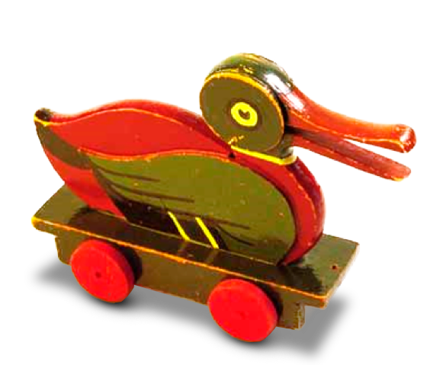
Let’s try…
Place the 6 bricks in front of you.
How quickly can you build a duck?
Notes:
Let’s Try…
Ask the participants to build a duck using the 6 bricks from the small bag in their Academy Teacher’s Kit.
Explain that this activity encompasses all the elements of LEGO Education’s learning philosophy, including hands-on and “minds-on” learning, and creative problem-solving.
Tell them that most importantly, it demonstrates the power of imagination in a learning environment and how energy is released when people do something fun.
Remember to say/cover the following points:
Instead of talking so much about what hands-on learning can do, let’s try a simple experiment ourselves.
Please find the small bag with yellow and red bricks in your Academy Teacher’s Kit, open it, and place the 6 bricks on the table in front of you, but don’t start building anything yet (even if it’s tempting).
I have a little building challenge for you:
You’ll have 30 seconds to build a small model using all 6 bricks.
As soon as you’ve finished, please place your model on the table at the front of the room.
Please build a… DUCK!
When everyone has finished, gather everyone around the table to look at the ducks.
Facilitate a discussion around the following questions.
What do you think when looking at the ducks?
Why are they all different?
To get the conversation going, ask some of the participants how they used the red bricks. They might have used them for the feet, wings, beak, tail, etc., because they thought of sitting, walking, flying, swimming, etc., ducks.
Make the following points:
You were all given the same resources (the same 6 bricks).
You were all given the same amount of time (30 seconds).
You were all given the same task (build a duck).
You all contributed with different solutions, and all of them are correct.
With LEGO bricks as a tool, you have the chance to create your own solution to the same question.
You can challenge your students at an individual level and they can all succeed!
It’s important to build confidence. We often talk about “low entry, high ceiling,” so we start with an activity everybody can solve, and build up from there.
Tips
Increase the building time to one minute for participants with little or no LEGO building experience.
If some participants have already done the duck activity before (e.g., at a conference), challenge them to build the duck:
Using only one hand
With their eyes closed
Inside the bag, without opening it
Don’t dictate anything regarding the design of the duck (e.g., studs have to face down)
Motivate the participants during the activity (e.g., say things like: “You don’t have time to think and plan!”; “Go, go, go!”; “15 seconds left!”; “5, 4, 3, 2, 1, and stop building!”).

Slide 7
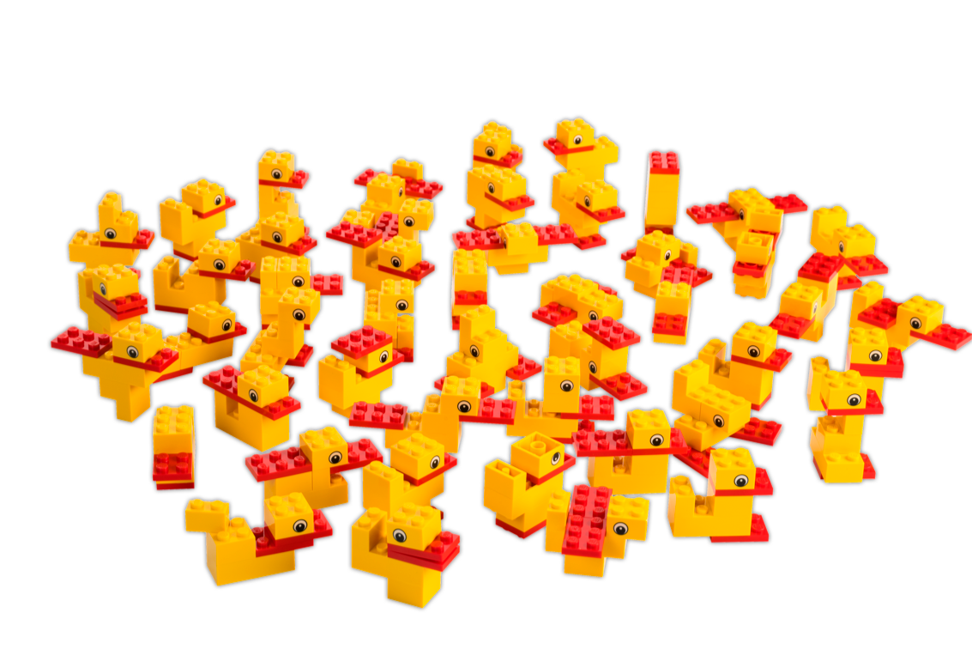
The Power of Imagination
Notes:
The Power of Imagination
Summarize and explain what the participants have learned from the duck-building task.
Remember to say/cover the following points:
It’s all about the power of imagination.
The brick is a tool for learning.
This task has a low entry and a high ceiling. It’s easy to get started but there’s no real limit to where you can take your model! This type of activity is excellent for creating a state of flow.

Slide 8
What happened?
Emotional regulation
Self-efficacy
Self-regulation
Visual search
Long-term memory
6
LEGO® bricks
Symbolic representations
Attention
Kinesthetic awareness
Mental imagery
Spatial visualization
Imagination
Sensory-motor skills
Pretense
Mental rotation
Visual perception
Working memory
Imitation
Spatial abilities
Adaptive social functioning
24
Skills are used
Fine motor skills
Perspective-taking
Short-term memory
Self-assessment
Cognitive flexibility
Model developed by the LEGO Foundation
Notes:
What happened?
Discuss the skills that might’ve been activated during the duck building activity.
Remember to say/cover the following points:
Now we’ve played a little with these 6 bricks but what’s actually happened?
We often tend to think that, of course play has a value because children enjoy it but it’s not really serious, there’s no real learning outcome.
But there is! Being playful like you were when building your duck, by experimenting with things, trying things out by taking them apart and putting them together again, and taking risks with new ideas, is the ultimate way of learning.
While you didn’t have time to really think during the 30 seconds you were building, your brain was actually working like crazy.
Which skills did you use in order to build your duck?
Let the participants identify a few skills themselves before showing the 24 skills on the slide.
The Research & Learning Department of the LEGO Foundation has looked at this activity and identified skills that could be relevant when building a duck.
Present the list of skills, acknowledging the ones that have already been identified by the participants, and highlight just a few additional examples, e.g.,:
Symbolic representation
The ability to associate objects, actions, or symbols with a particular meaning. Like when you were looking for elements that had similarities to a duck.
This is important for language development when understanding the meaning of letters, words, and numbers in relation to everyday objects.
Spatial abilities
Thinking about and manipulating objects in 3-D. Like when you visualized what you wanted to build, and then manipulated the elements to make the duck.
This is essential for your ability to visualize and imagine a situation, and look at it from different directions. Perhaps even more critical, this plays a key role in mathematical thinking when children learn to sort, count, and quantify objects.
Self-regulation
Most of you felt a little stressed during this task but no one failed.
Your ability to regulate your emotions and motivation, while setting yourself the goal of completing the duck and working toward that goal, is called “self-regulation.”
It’s important for you to retain control and lead yourself when you’re setting a goal and trying to achieve it.
Sometimes we consider abilities such as concentration, self-control, idea visualization, and spatial understanding to be soft skills, or things that are a by-product of learning. But they’re so much more than that. The skills that you use when you’re motivated to play and make things are the skills that are most critical to problem-solving and creative thinking. These are also a fundamental way of learning language, reading, writing, and mathematics.
Play is learning! Even a simple activity, like building a duck, trains basic skills that are critical to different development areas.
Tips
You can either discuss the skills when everyone is still gathered around the ducks or ask the participants to take their ducks back to their seats first.
If the participants struggle to identify skills, support them by asking about the process (e.g., the first thing they did when they were given the task, what they did next) or what they found challenging, etc.
Feel free to point out other examples by identifying the skills used in preparation before and after building the duck (e.g., when thinking about the time pressure and requirements before beginning the task, or comparing their solution to others’ solutions and starting to think about ways of combining them afterward).

Slide 9
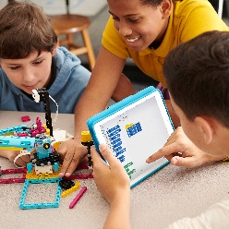
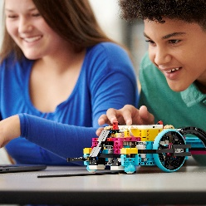
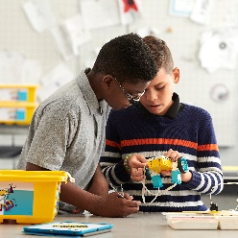
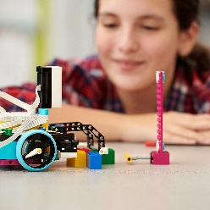
Characteristics of Play
Joyful
Meaningful
Actively engaging
Iterative
Socially interactive
Model developed by the LEGO® Foundation
Notes:
Characteristics of Play
Compare the compiled list made by the participants with the characteristics of play listed by the LEGO Foundation.
Use the talking points below to explain the indicators associated with each of the characteristics.
Remember to say/cover the following points:
The LEGO Foundation has also researched the common characteristics of playful experiences and boiled them down to these 5 characteristics.
Joyful – taking initiative, indulging curiosity, based on inner motivation
Meaningful – takes place in a familiar environment, fact-based, provides relevant context
Actively engaging – working hands-on, learning by doing, learning through experiences, “hard fun”
Iterative – experimenting, learning through imagination, comparing, predicting, testing, and reflecting
Socially interactive – collaborating, co-constructing knowledge, inspirational, encourages reflection, challenges understanding
Note: It’s important to say that:
This list isn’t exhaustive but these are the 5 characteristics we see most often when looking at play.
Not all of these characteristics have to be present in order for an experience to be considered playful, but many of them often are (e.g., not every playful experience has to be socially interactive, but they often are).
Compare these characteristics with the ones you’ve collected on the board.
With play at the core of the experience, LEGO Education sees so many great enablers for learning. That’s why play is the perfect starting point for learning!
Tips
Here’s some additional information you can use to elaborate on the five characteristics covered on this slide:
Joyful
Example: When you do something because you’re internally motivated, you do it because you want to and because doing it brings you joy, not because you feel an obligation or duty.
Description: When children enjoy what they’re doing and are internally motivated, they naturally seek information, take pride in challenges, and remember things for longer. “Joy” means being motivated to take initiative, being open to new experiences for exploring gaps in knowledge and understanding, and feeling a spark of curiosity.
Meaningful
Example: If the situation they’re in doesn’t make sense or isn’t meaningful, children will quickly lose interest. Playful situations often take place within a meaningful context.
Description: Children learn through experiences that are relevant and meaningful by exploring things in the environments that are familiar to them. They process and sort information and experiences that are relevant to their own lives, and remember these experiences by turning familiar contexts into symbols, categories, and patterns. This shapes children’s mental models and allows them to challenge themselves at their own level and to absorb new experiences.
Engaging
Example: When children learn how to tie their shoelaces, they can’t learn it from a book, they have to actually do it in order to learn. After a while, their hands will “remember” the sequence.
Description: When children are active, they’re not only sitting, watching, and listening but using their body and mind together to remember things better and more deeply. Active hands-on engagement stimulates multiple channels in the brain and makes children active creators of meaning, instead of passive recipients of information who experience the world in only one way.
Iterative
Example: When children want to learn how to ride a bike, they probably won’t succeed right away. They have to try again and again, modifying their movements to understand balance before they can actually ride a bike.
Description: Imagination allows children to come up with new ideas and things, which do not yet exist. Children learn most effectively when they experiment with ideas, produce something new, and iterate by comparing new information to their previous understanding. Using imagination and iteration enables children to think back and forth in time in order to plan, predict, test, and reflect on outcomes.
Socially Interactive
Example: Play often happens in a social context. It’s rarely something that goes on when children are isolated and without peers (e.g., playing hide and seek, team sports, etc.).
Description: Children co-construct their knowledge in dialogue with other people. The brain learns effectively through social interactions, jointly creating something, and sharing joy. As part of social interactions, other people’s contributions inspire us, create opportunities for reflection, and challenge our own understandings.

Slide 10
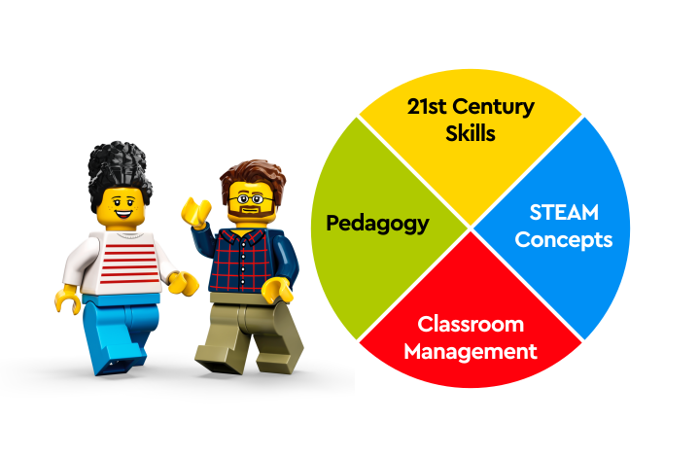
LEGO® Education Professional Development Self-Guided Learning
pd.LEGOeducation.com
Interactive Competency-based Courses
Product Support
Additional Learning Resources
Notes:
LEGO® Education Professional Development Self-Guided Learning
Direct the participants to the free, online, on-demand, self-guided learning of the LEGO Education Professional Development program at pd.LEGOeducation.com.
Remember to say/cover the following points:
If the participants have already prepared for this course at pd.LEGOeducation.com:
Remember you can always return to the online self-guided learning of the LEGO Education Professional Development program to review and find additional guidance and product support, learn more about topics that are relevant to you and your teaching, and proceed to explore self-guided, interactive courses to learn, practice, and develop high-leverage teaching competencies in the 4 core categories Pedagogy, 21st Century Skills, STEAM Concepts, and Classroom Management.
Depending on how familiar they already are with self-guided learning at pd.LEGOeducation.com and the content on it, briefly walk them through the areas most relevant for them.
If the participants are not familiar with self-guided learning at pd.LEGOeducation.com:
show the Intro Video, and/or
open pd.LEGOeducation.com and follow the Demo Script, focusing on the areas most relevant for your group.
Use the next slide to give a quick overview of what specific SPIKE Prime content is available at the platform.
Tips
If possible, have the participants log in to pd.LEGOeduction.com before the training so they have already taken this first step and can start benefitting from the opportunities for self-guided learning.
You can consider moving this slide to before one of the short breaks, so participants can explore pd.LEGOeducation.com during the break, if they want to (but do not push them to spend their break on this).
Briefly mention self-guided learning at pd.LEGOeducation.com at the beginning of the training after the introduction to the LEGO Education approach to learning and before the introduction to the product to make participants aware that they can always go there to revisit information and learn more.
Remember to refer the participants to self-guided learning during the course wherever it could support their professional development, e.g., if you:
Feel that they might want to revisit any content you covered during the course.
See that they want to learn more about a certain topic.
See that they might need additional support with regards to specific topics once they start teaching.
Are working on a topic that directly links to one of the competency categories so they could continue learning, practicing, and developing high-leverage teaching competencies on the platform.
Consider having pd.LEGOeducation.com opened in the background so you can quickly direct them to a relevant place you have referred to, e.g., during a recap session or discussion.
The platform and the Intro Videos are available in several languages.
The Intro Videos, Demo Script, and Access Guide can be found on the Teacher Training Resources SharePoint in the “Online Learning Platform” folder.
Virtual Delivery
Share your browser for walking the participants through digital self-guided learning on pd.LEGOeducation.com, or, especially, if (some of) the participants have already been to pd.LEGOeducation.com, consider asking one of them to share their browser and show what they have already gone through and how it supported them so far. You could then highlight a few more places that might be relevant for this group.

Slide 11
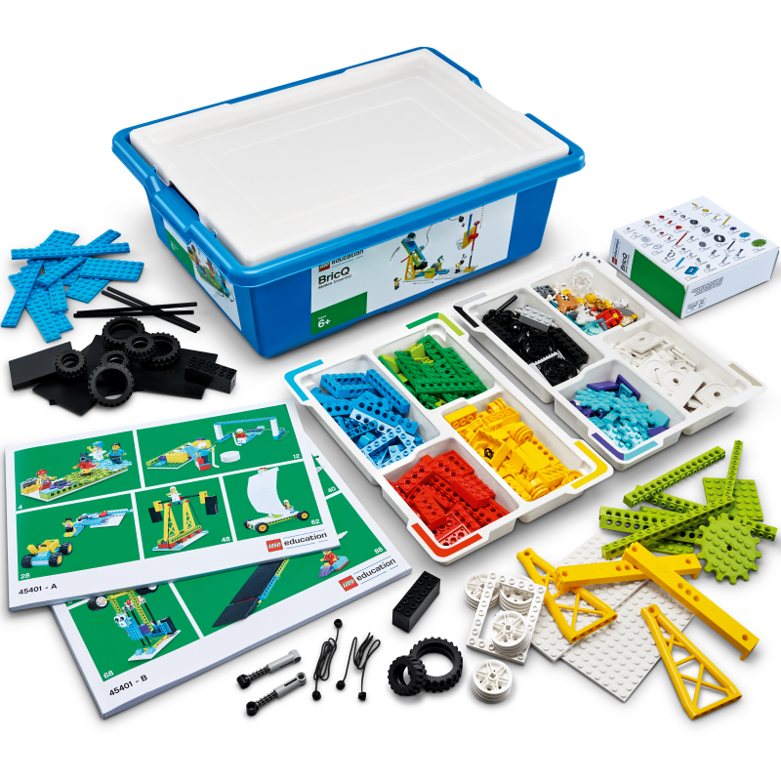
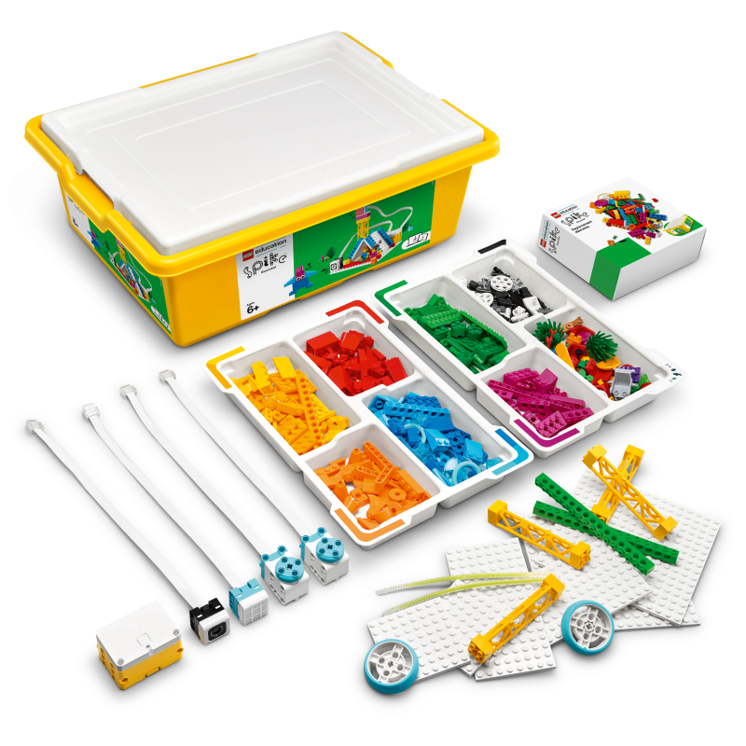
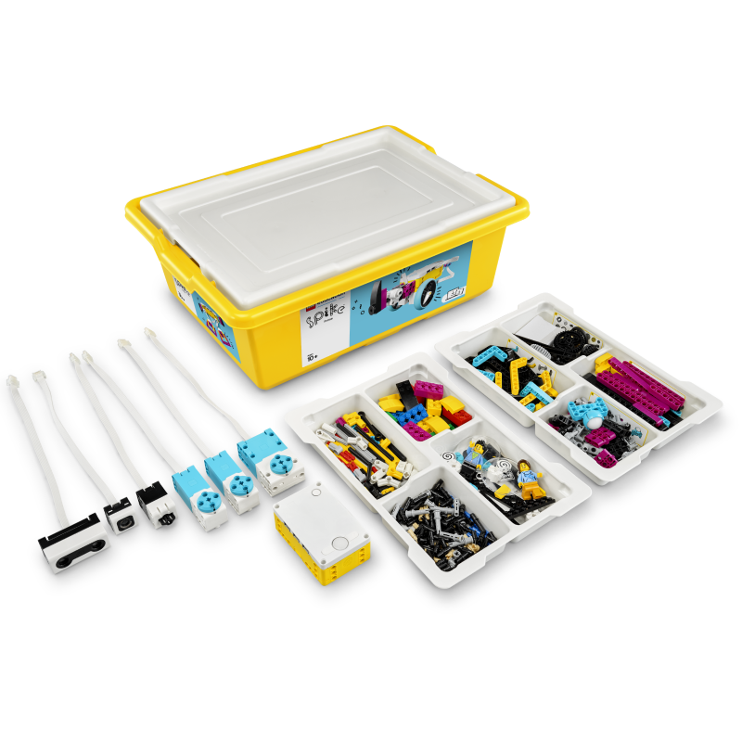
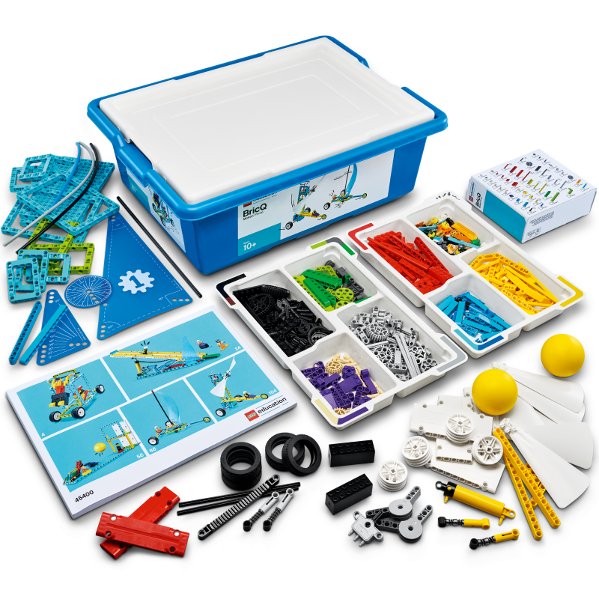
Your Products
BricQ Motion Essential
Spike Essential
Spike Prime
BricQ Motion Prime
(Grades 1-5)
(Grades 1-5)
(Grades 6-10)
(Grades 6-8)

Slide 12
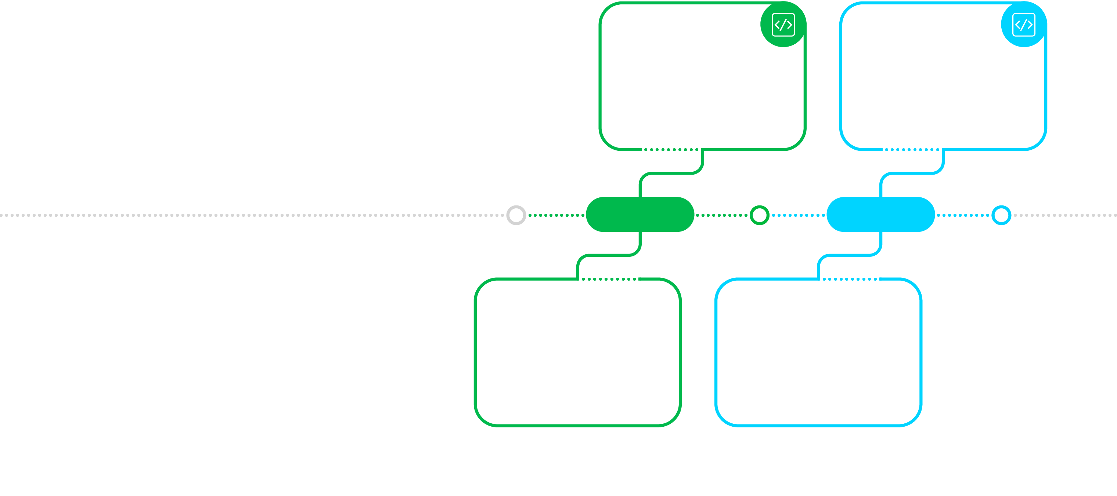
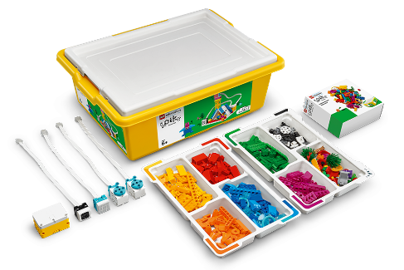
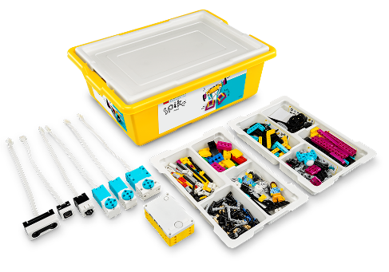
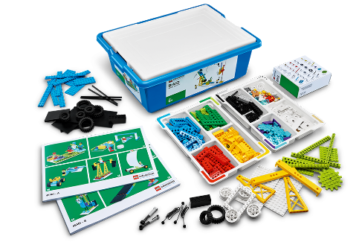
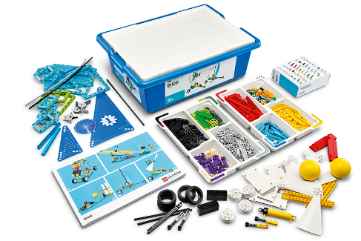
These are part of the LEGO Learning System
An intuitive, inclusive, and highly adaptable hands-on learning system.
LEGO® Education
SPIKE™ Essential
LEGO® Education
SPIKE™ Prime
LEGO® Education
SPIKE™ Prime
PRIMARY
MIDDLE
LEGO® Education
BricQ Motion Essential
LEGO® Education
BricQ Motion Prime
Notes:
SPIKE Prime is part of the LEGO Learning System
Use this slide to explain the LEGO Learning System and how SPIKE Prime fits into it.
Remember to say/cover the following points:
SPIKE Prime is part of the LEGO Learning System.
The LEGO Learning System offers a range of recognizable components across products. These include curriculum, programming, bricks, hardware, and professional development.
The LEGO Learning System offers:
A curriculum with clear intentionality and grade progression, scaffolded to support teachers and students in building essential skills.
Programming activities that challenge students to apply coding principles in a STEAM context at all grade levels. The LEGO Learning System is based on a coding progression that starts with simple Icon blocks and builds up to text-based programming using recognized coding languages.
A system of LEGO elements provided in classroom sets that allow students to build, tinker, and experiment hands-on.
A system of LEGO hardware elements that are easy to build with and seamlessly integrate as a natural part of students’ STEAM creations.
A competency-based Professional Development Program that inspires teachers to learn, practice, and master the competencies necessary to facilitate playful, hands-on STEAM learning.
SPIKE Prime can be combined with BricQ Motion Prime to expand students’ learning in “combo lessons.”
You can find all of our standards-aligned lesson plans on legoeducation.com/lessons.

Slide 13
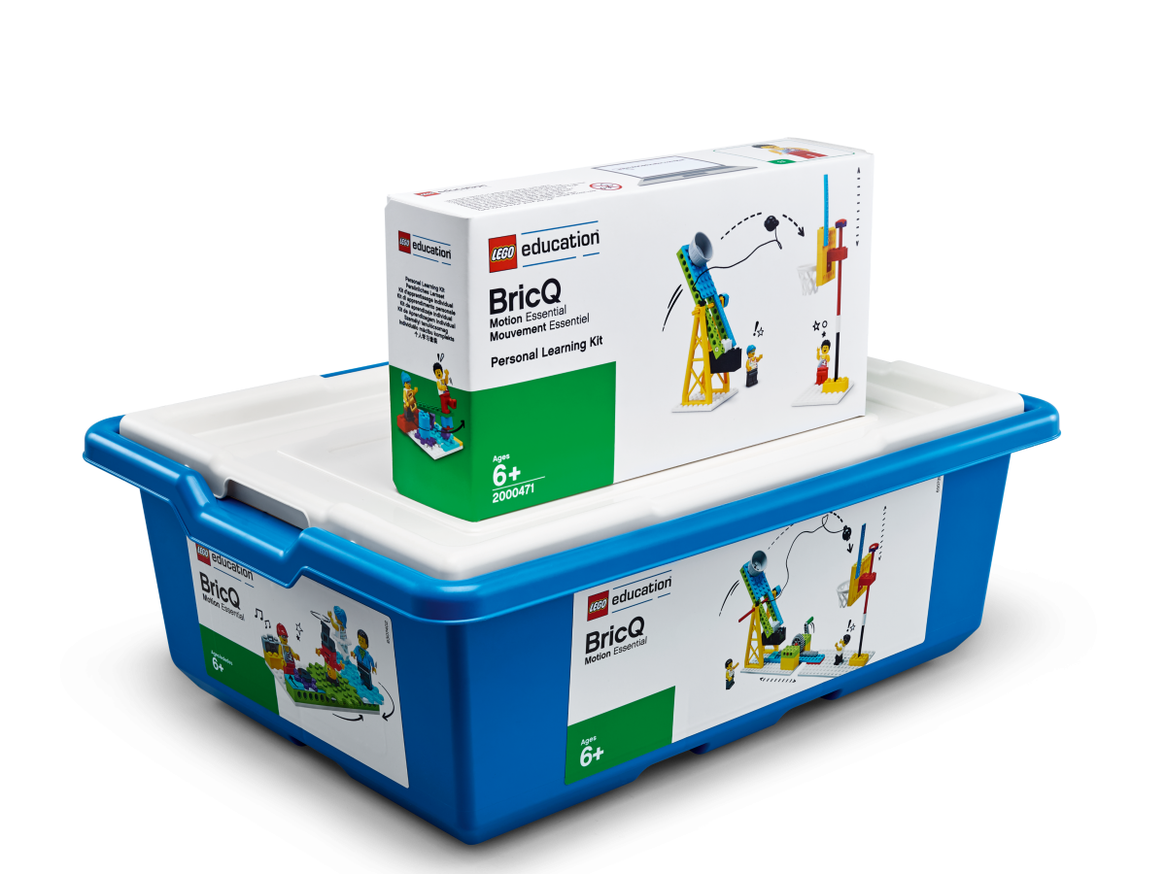
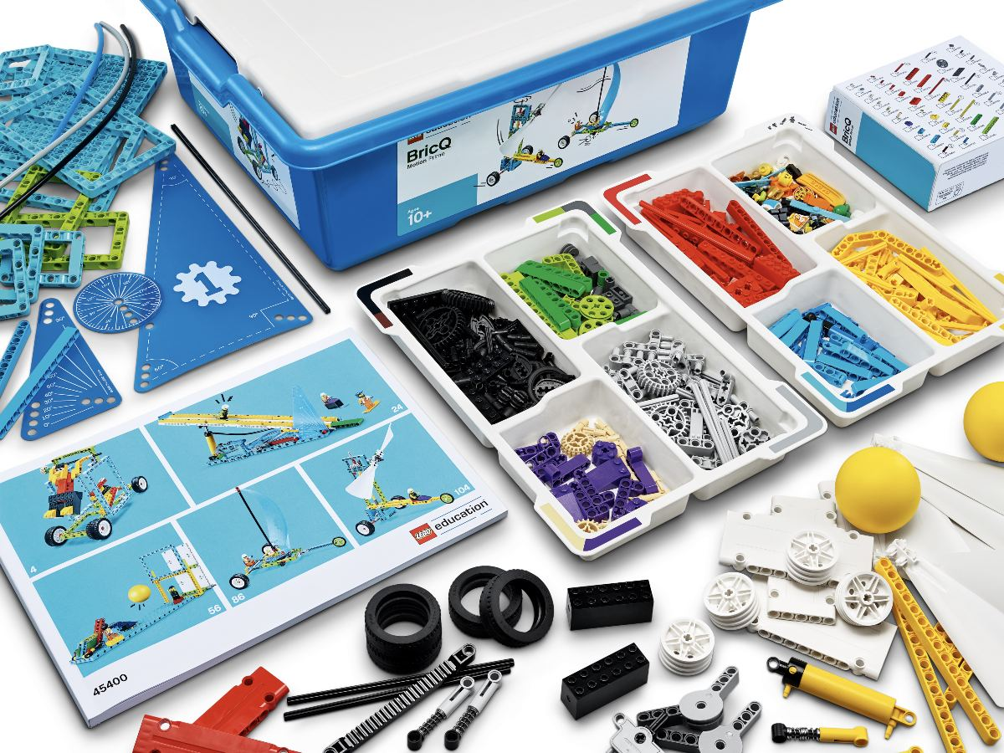
BricQ Motion: Purposeful Analog Learning for a Digital Steam World
What is LEGO Education’s BricQ Motion?
BricQ Motion resources are introductory learning solutions that enable teachers and students to feel more confident in STEAM learning by removing digital barriers and teaching physical science through fun and engaging sports-themed lessons for grades K-8.

Slide 14
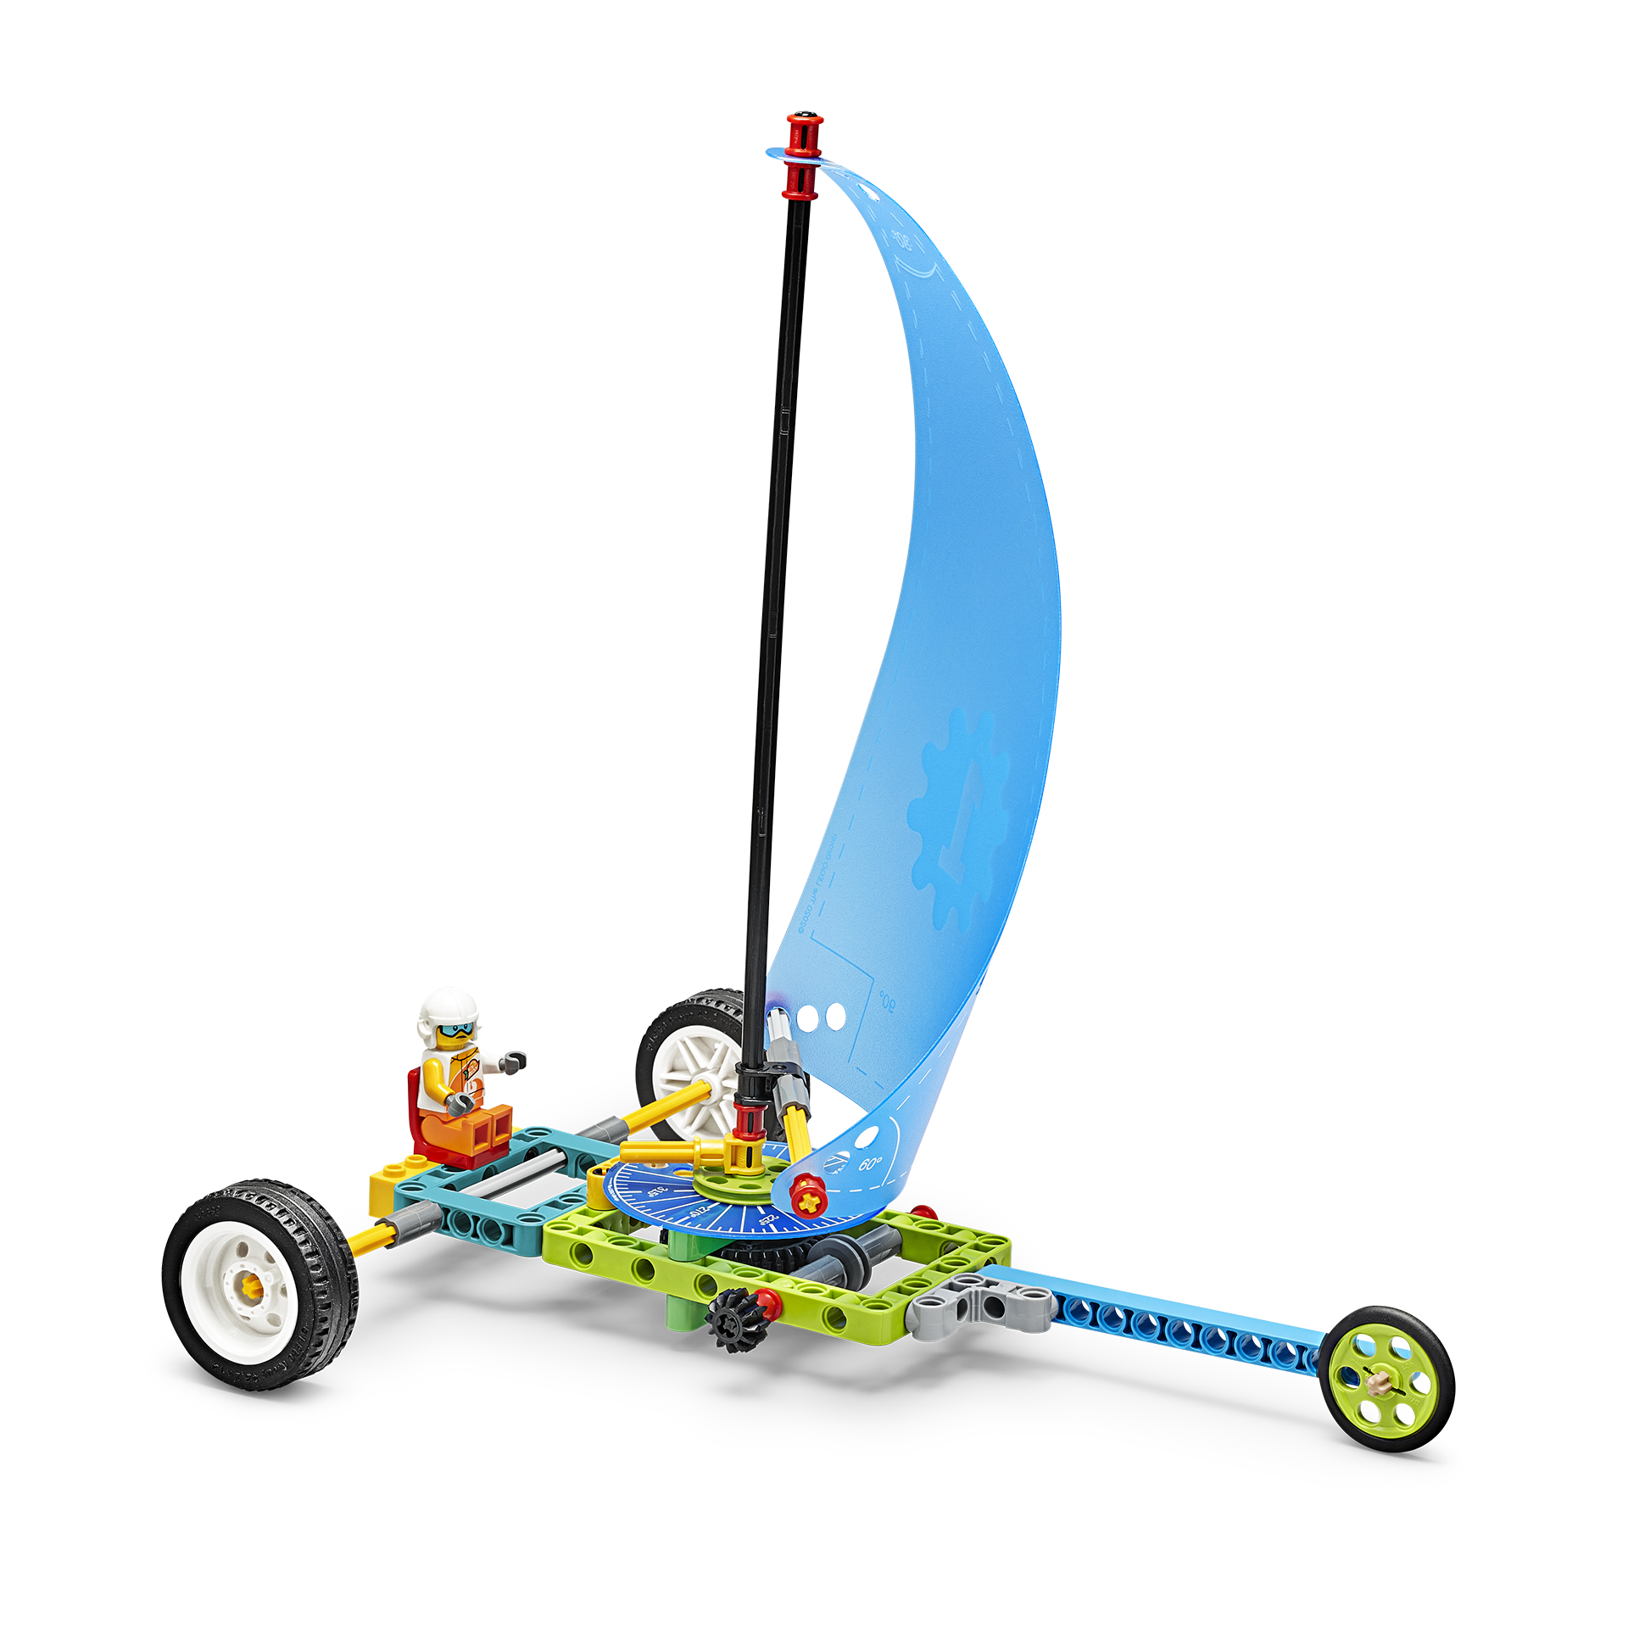
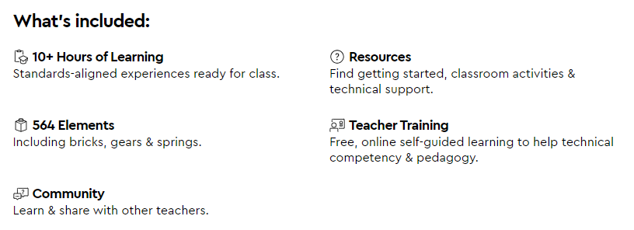
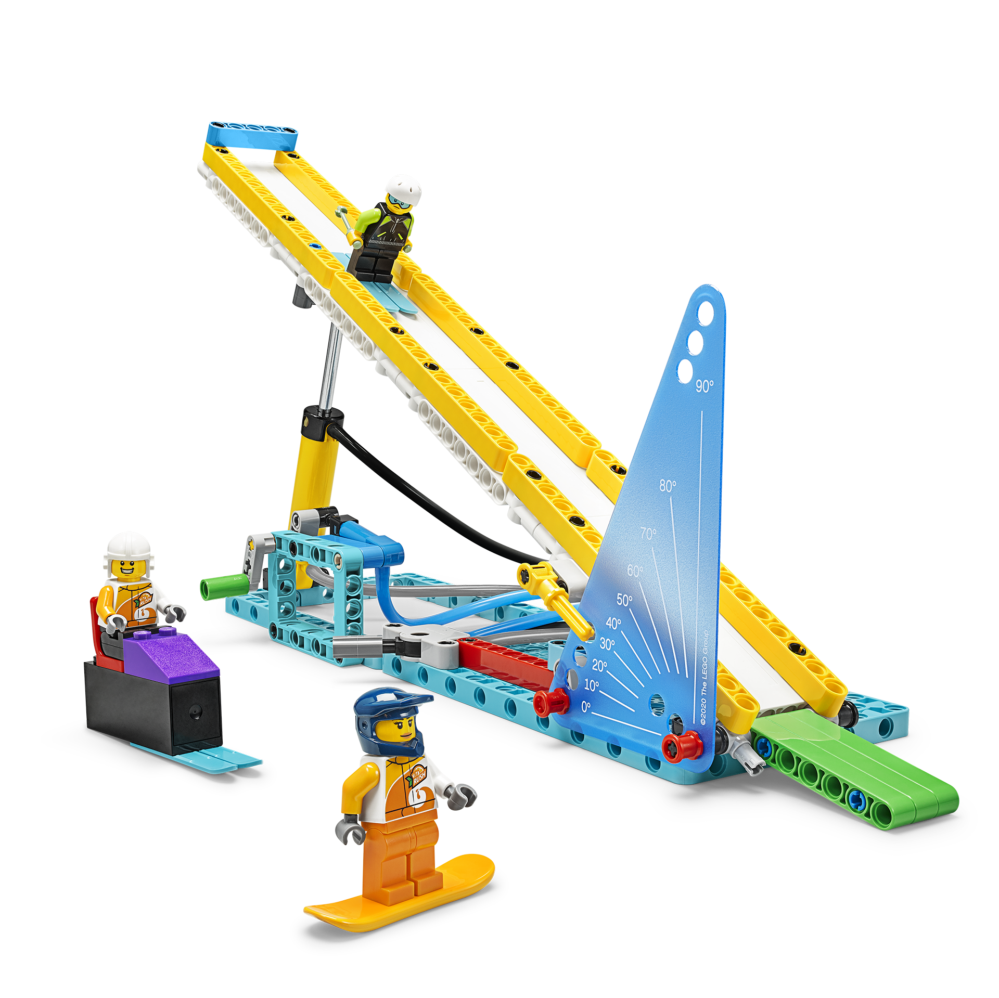
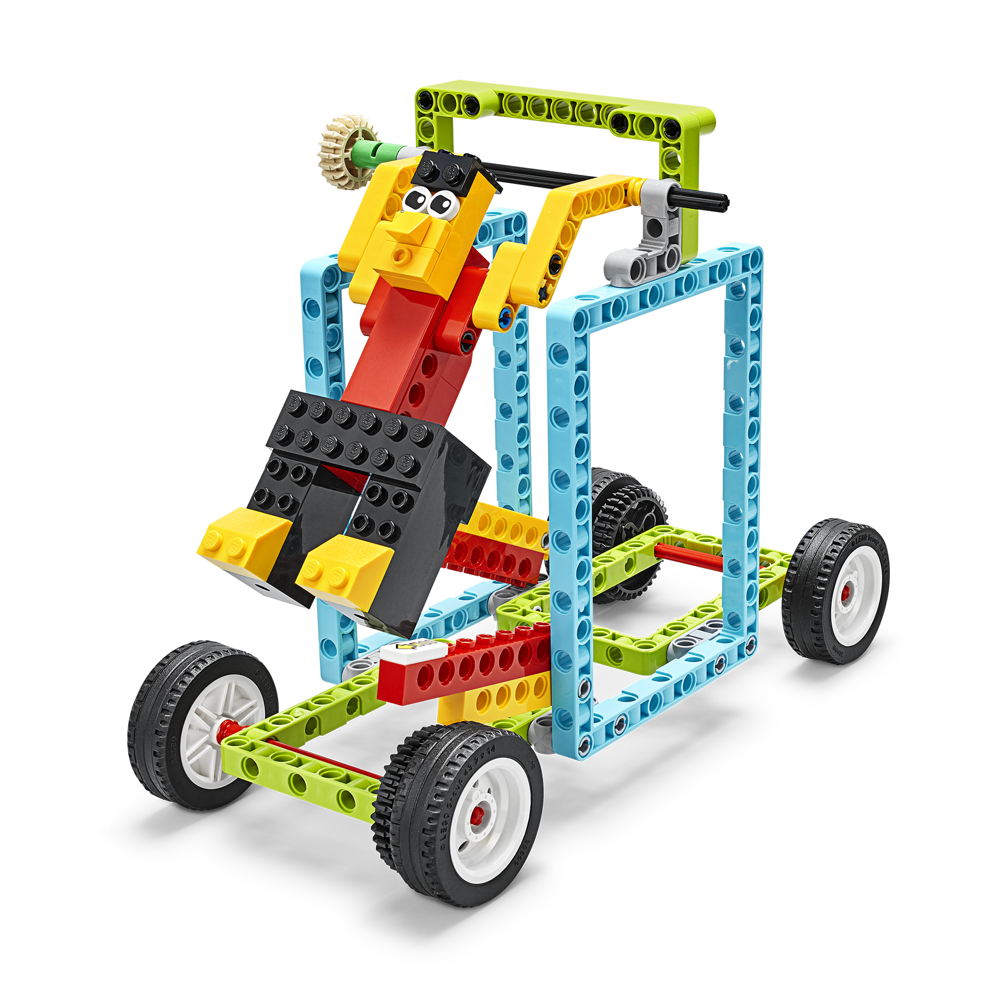
BricQ Motion Prime
Each set supports 2 students in the classroom.

Slide 15
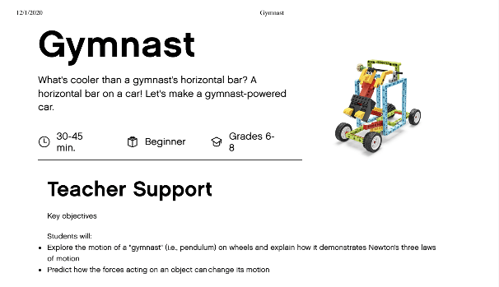
Sample Lesson
The Gymnast lesson comes with detailed plans, including hybrid learning resources and the alignment to education standards:
Use collaborative tools to expand students' authentic, real-world learning experiences by engaging virtually with experts, teams and students, locally and globally.
Create learning opportunities that challenge students to use a design process and computational thinking to innovate and solve problems.
Use assessment data to guide progress and communicate with students, parents and education stakeholders to build student self-direction

Slide 16
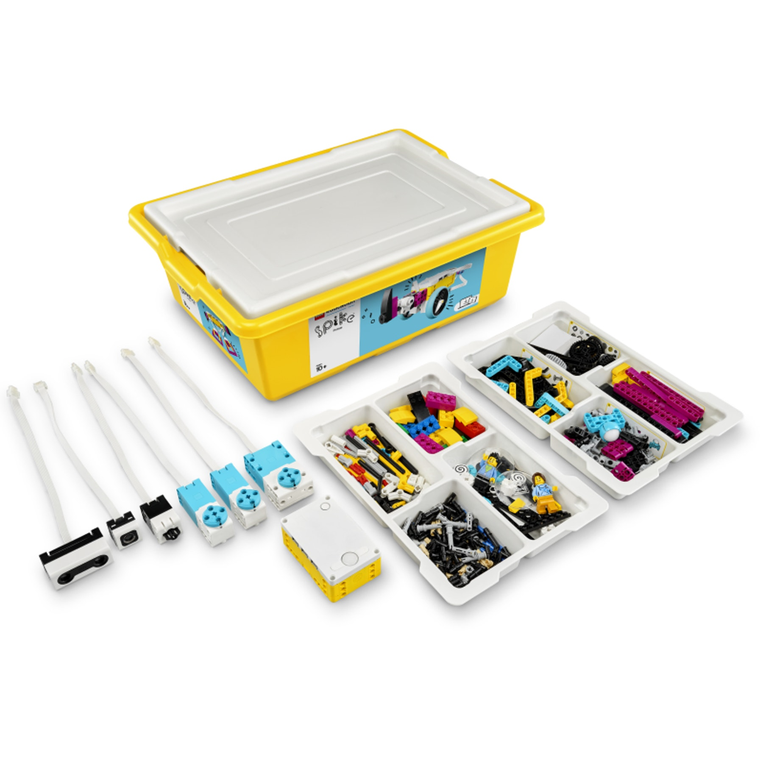
SPIKE Prime kit
The GO TO STEAM Learning Kit for Grades 6-8 and beyond
Combining colorful LEGO building elements, easy-to-use hardware, and an intuitive drag-and-drop coding language based
on Scratch, SPIKE Prime continuously engages students through playful learning activities to think critically and solve complex problems, regardless of their learning level.

Slide 17
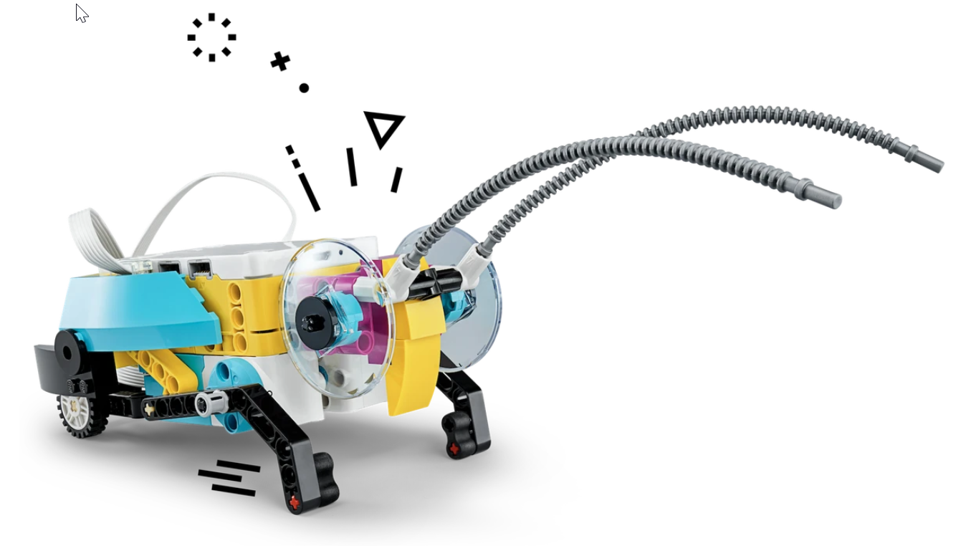
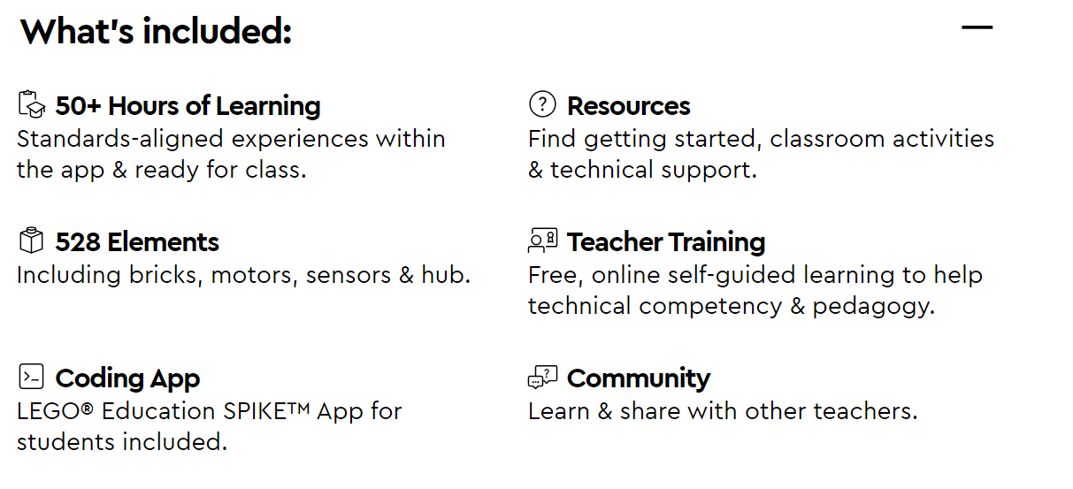
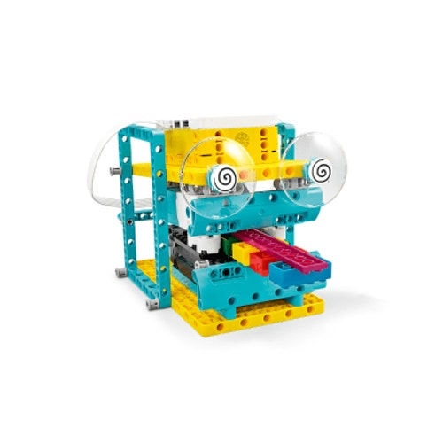
LEGO® Education SPIKE™ Prime Set
Each set supports 2 students in the classroom.

Slide 18
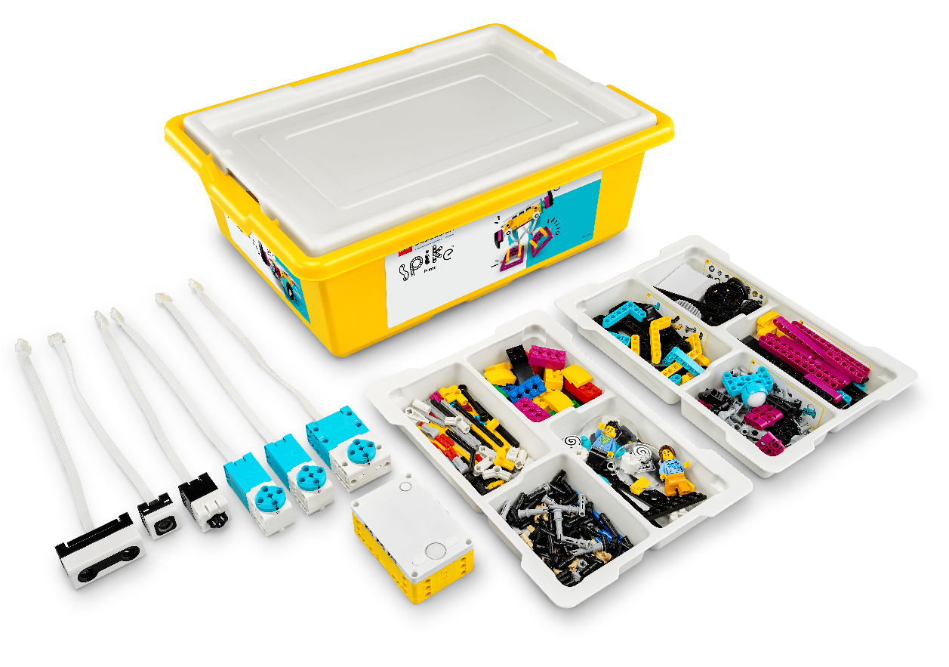
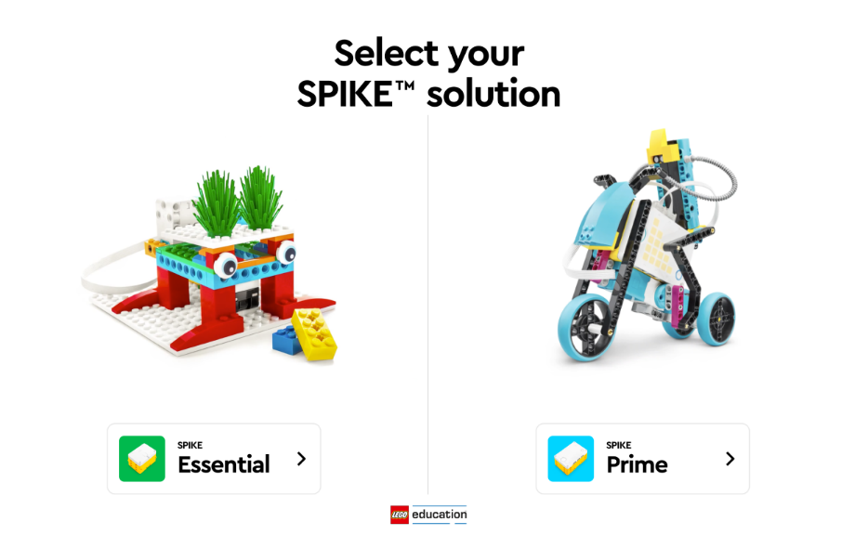
Get started!
SPIKE™ Prime Set
SPIKE™ App
Notes:
Get started!
Introduce the components of the LEGO® Education SPIKE™ Prime solution and the first steps in getting started.
Remember to say/cover the following points:
So what do you need and how do you get started with SPIKE Prime?
Let’s imagine that the SPIKE Prime Sets have just arrived at your school.
I’d suggest that you designate one of the sets as your “personal teacher set” for preparing, testing, and planning.
If you want, you can let the students unpack the other sets.
The first thing you’ll see when you open a set is a top card suggesting that you:
Insert the Rechargeable Battery into your SPIKE Prime Hub
Turn it on
And go to LEGOeducation.com/start to download the SPIKE App
Once you’ve installed and opened the app, “Get Started with SPIKE Prime” will guide you through your first steps.
We’ll start by following these steps, just like you’d do in your classroom.
The “Teacher Preparation” section of the app will guide you through preparing the sets for their first use.
Each set has 2 sorting trays, and there’s a sheet with stickers you can use to label each of the 8 compartments.
Each compartment holds a certain type of element (i.e., beams, wheels and gears, or connectors).
This will help to keep the sets sorted so students can quickly find the elements they need.
The LEGO elements come pre-sorted in numbered bags, so you can just open them and dump the bricks into the respective compartment.
You can also label each box and its electronic components to make it easier to manage the sets. This will help you return the components to the right box, if they get mixed-up.
That’s it. You’re ready to go!
There is also a course in the Professional Development platform to support you with this. It’s called Prepare to Teach: Materials.
With SPIKE Prime, students usually work best in pairs, and this is how I’d like you to work today.
Please find a partner and sit together, sharing a set and a device.
Tips
If you’re using new sets, consider whether you want to prepare the sets before the course or have the participants do it now.
Important: The first (and only the first) firmware update of the SPIKE Prime Hub requires a USB connection and a Windows 10 or MacOS device!
If someone asks whether they need to purchase any additional resources to use SPIKE Prime, you can tell them that there’s an Expansion Set and that SPIKE Prime can of course be combined with other LEGO (Education) solutions, but that the SPIKE Prime Set and SPIKE App contain everything they need for now.
There’s an unnumbered bag in each set, which contains replacement elements in case something gets lost.
The Rechargeable Battery for the Hub comes pre-charged so it doesn’t have to be charged before the first lesson.
The SPIKE App is available for devices (not including smartphones) running:
Win10
Chrome
Android
iOS
MacOS
Let the participants open the app and follow your introduction.
You can either place the sets on the tables before the course begins or hand them out now before proceeding to the “Getting Started” steps.

Slide 19
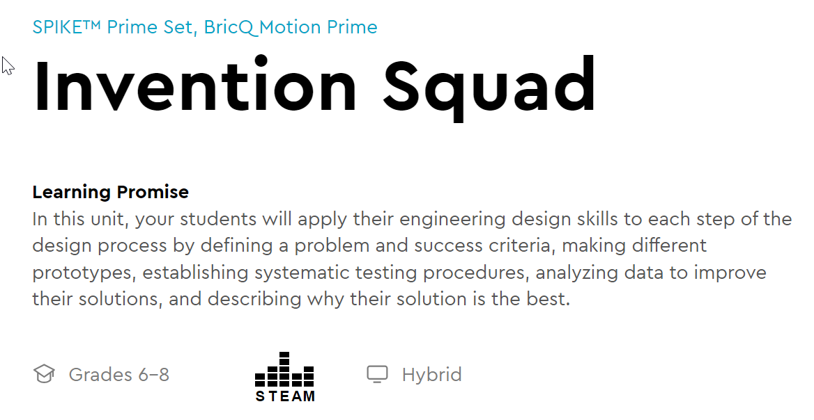
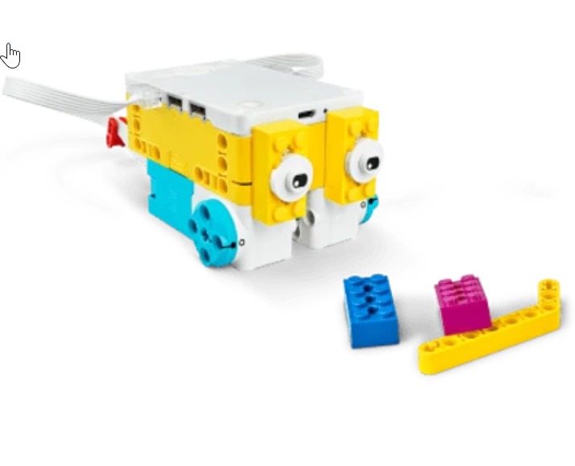
Hopper Race Design multiple prototypes to find the most effective way to move a robot without using wheels.

Slide 20
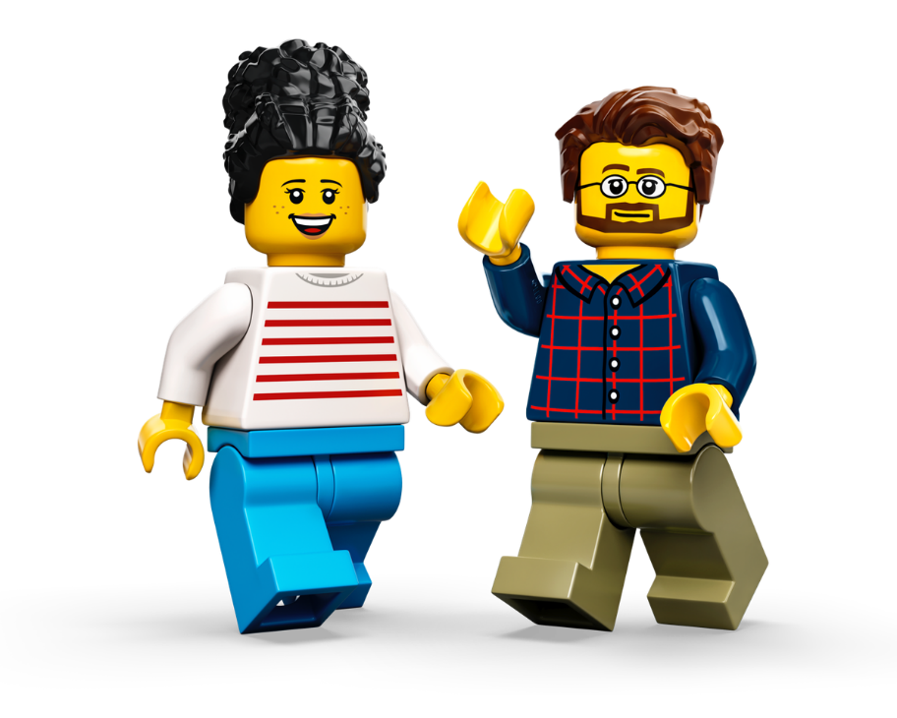
LEGO® Education SPIKE™ Professional Development
Self-Guided Learning – online & on-demand at pd.LEGOeducation.com
Product Support video tutorials
Prepare to Teach – Materials tutorial
Unit and Lesson tutorial
Guided Lesson tutorial
Troubleshooting tutorial
Programming Basics tutorial
SPIKE™ Coding and Troubleshooting learning plan
Coding tutorials (Icon and Word Blocks), modeled with SPIKE™ Essential
Troubleshooting tutorial, modeled with SPIKE™ Essential
Additional Coding and Computational Thinking Resources, modeled with SPIKE™ Essential
Notes:
SPIKE™ Prime Professional Development
Use this slide to present an overview of the self-guided professional development materials that are available for SPIKE Prime.
Remember to say/cover the following points:
This is a complete overview of the SPIKE Prime product support that’s available to you on the Professional Development Platform.
We’ve talked about these throughout the day but let’s quickly recap.
Walk the participants through the bullets on the slide.
Please highlight that the SPIKE™ Coding and Troubleshooting learning plan is a mix of resources modeled with both SPIKE Essential and SPIKE Prime.
Tip
Keep the Professional Development Platform open in a browser tab so you can quickly switch back and forth to show different elements as you mention them.

Slide 21
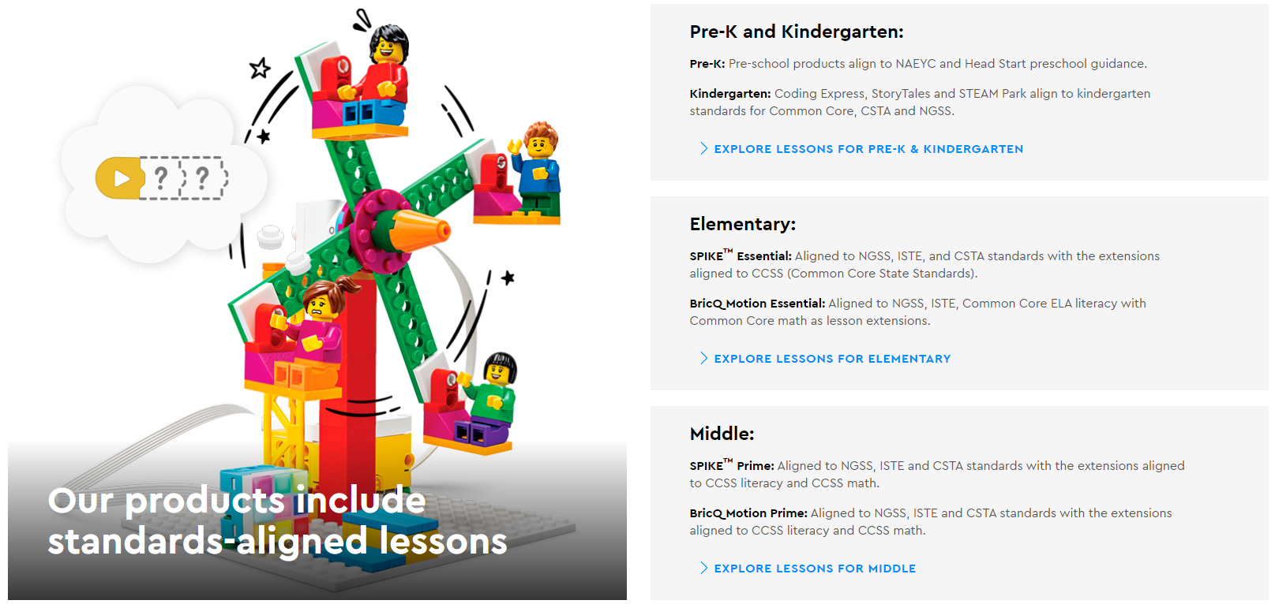
Online Lessons
https://education.lego.com/en-us/

Slide 22
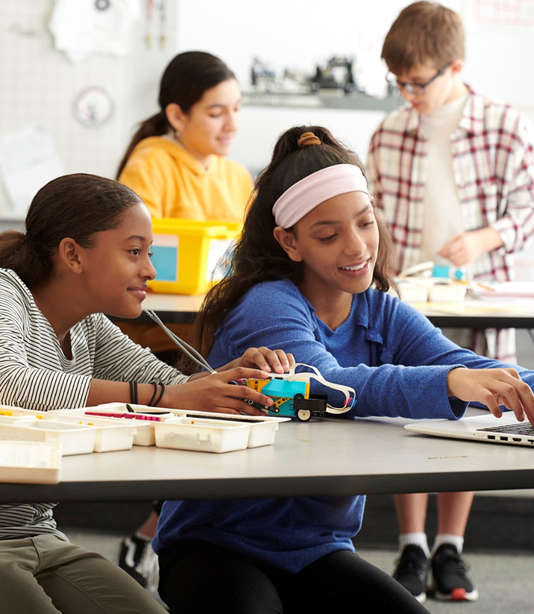
Classroom Management
Preparation
App
Sets
Storage
Tools
Space
Lesson Planning
Practices
Rules
Tidy up
Lost & Found
Evaluation
Checking & Sorting
Notes:
Classroom Management
Walk the participants through the most important aspects of classroom management.
Share your tips and tricks.
Remember to say/cover the following points:
Highlight some of the following tips and tricks that you haven’t discussed yet and that you feel are relevant for this group (i.e., aspects they’ve said they’re especially concerned about).
Preparation:
App:
Download the SPIKE™ App to all devices.
Download any units, if needed.
Follow the “Getting Started” steps.
Sets:
Before using SPIKE Prime for the first time, unpack and prepare the SPIKE Prime Sets, following the “Teacher Preparation” section in the SPIKE App. To save time, prepare one set for yourself and let the students do the other sets.
Be aware that the first (and only the first) firmware update of the SPIKE Prime Hub requires a USB connection and a Windows 10 or MacOS device.
Assign a unique name to each Hub to make Bluetooth pairing easier.
If possible, assign each set to the same students for the whole term or as long as they’ll be using it. Put a sticker on the box with their names so that students will pay more attention to keep “their” set neat and complete. If this isn’t possible, use numbers or other labels for the sets.
Storage:
Designate a cabinet, wheeled cart, or other space for storing the sets, and potentially any creations, between lessons.
Some lessons can be completed within 45 minutes, others will take longer, and adding the math and/or language extension will require additional time. So, if other groups won’t need to use the sets in between, you might sometimes want your students to keep their models intact for the next lesson.
Many of the models will also fit into the storage box, where they can be stored for the next lesson.
If they don’t fit, put them on top of the storage boxes or mark them (e.g., using different colored LEGO bricks) that make sure that each group can find their model for the next lesson.
Especially if you’re only (or mostly) using Bluetooth during lessons, consider how, when, and where you’ll charge the Hubs. The Hubs will charge automatically as soon as they’re connected via USB cable to any USB port or USB power supply. Some schools have a certain place where all of the Hubs are placed at the end of each lesson/day to be charged.
Tools:
Some teachers like to keep a box of often-used tools on hand (e.g., tape, yardsticks, cardboard, scissors).
It’s a good idea to print a reserve of copies of any test tables, city maps, etc., ahead of time so you’ll have them whenever you choose to run the respective lesson.
Use a binder to store printed copies of the building instructions for the tandem builds.
Space:
Make sure there’s enough space on the tables for working, and on the floor for testing or running creations.
Lesson Planning:
Choose the lesson you want to do, and try to complete it as if you were a student.
Adjust the lesson to meet your curriculum goals and plans.
Plan the lesson.
Prepare any specific resources you need.
Practices:
Rules:
Especially with younger students, work together to define a set of rules, like these, and post them somewhere in the classroom for everyone to see:
Everyone listens when someone else speaks
We only use elements from our own set
When the teacher claps, we all stop and take our hands off of our creations
Nothing else on the table and no open bags next to the tables
We use the lids of the plastic storage boxes as trays to work on or for carrying creations around the classroom
We are responsible for keeping our sets complete and sorted, storing them at the end of each lesson, and plugging in the chargers, if needed
Tidy up:
Leave enough time for students to store their creations, or to disassemble their creations and put the elements back into the storage box.
Lost & Found:
Designate a small jar or box for any pieces found on the floor or somewhere else (and tell everyone cleaning or working in the room about it).
If anyone is missing an element from their set during a lesson, they can look for it in the jar or box.
Some teachers also like to keep an extra set on hand for replacing missing elements.
Evaluation:
Take a few minutes after each lesson to evaluate it.
Compare notes with any colleagues at your school or on social media who are using SPIKE Prime.
Checking & Sorting
It shouldn’t be necessary to check and sort the sets on a regular basis but it could make sense to do this at the end of a term or after a bigger project.
If it’s not required for a project, avoid mixing the sets.
Each set already contains a replacement pack with extra elements.
Replacement packs are also available separately, and many individual elements can also be found on LEGO.com → Pick A Brick (or external sites).
Ask the participants if they have any other classroom management tips they’d like to share with the group.
Tip:
Mention these tips and tricks throughout the day, where it makes sense.

Slide 23
Managing LEGO® Education Materials
Establish a procedure for distributing materials to the students | EXAMPLE | PRO TIPS
Establish a procedure for distributing materials to the students | Designate one person who’s in charge of distributing materials | Check with IT for support
 | Setup a distribution area | Ensure that all Hubs have up-to-date firmware before distributing
 | Ensure that the required software has been downloaded and installed on all your student devices | Number/Name Hubs and Kits
 | Communicate the procedures for returning the materials | For SPIKE, download units to each device

Slide 24
Managing LEGO® Education Materials
Establish an inventory procedure that the students can follow to keep track of the pieces in their sets | EXAMPLE | PRO TIPS
Establish an inventory procedure that the students can follow to keep track of the pieces in their sets | Every LEGO Education set comes with a list of elements. Distribute an inventory sheet with each set and encourage students to take an inventory when the get the set and again at the end when they return it. | Control sharing between groups

Slide 25
Managing LEGO® Education Materials
Package material in advance of distribution to ensure that each group has everything they’ll need to complete their projects | EXAMPLE | PRO TIPS
Package material in advance of distribution to ensure that each group has everything they’ll need to complete their projects | Each package should include | Include information for inventory, IT support, Tips for Charging at end of the day and storage
 | A LEGO Education Set
 | Printed building instructions (if needed)
 | Student Worksheet(s) (if needed)
 | Batteries and Chargers
 | Any additional materials needed (e.g., ruler, tape, etc.)

Slide 26
Managing LEGO® Education Materials
Establish a return procedure | EXAMPLE | PRO TIPS
Establish a return procedure | Count and verify the sets. | You may have to clean elements.
 | Review the inventory sheets and check for missing elements
 | Designate someone to review the sets for missing elements and prepare them for the next session (e,g., replacing batteries and charging as necessary)

Slide 27
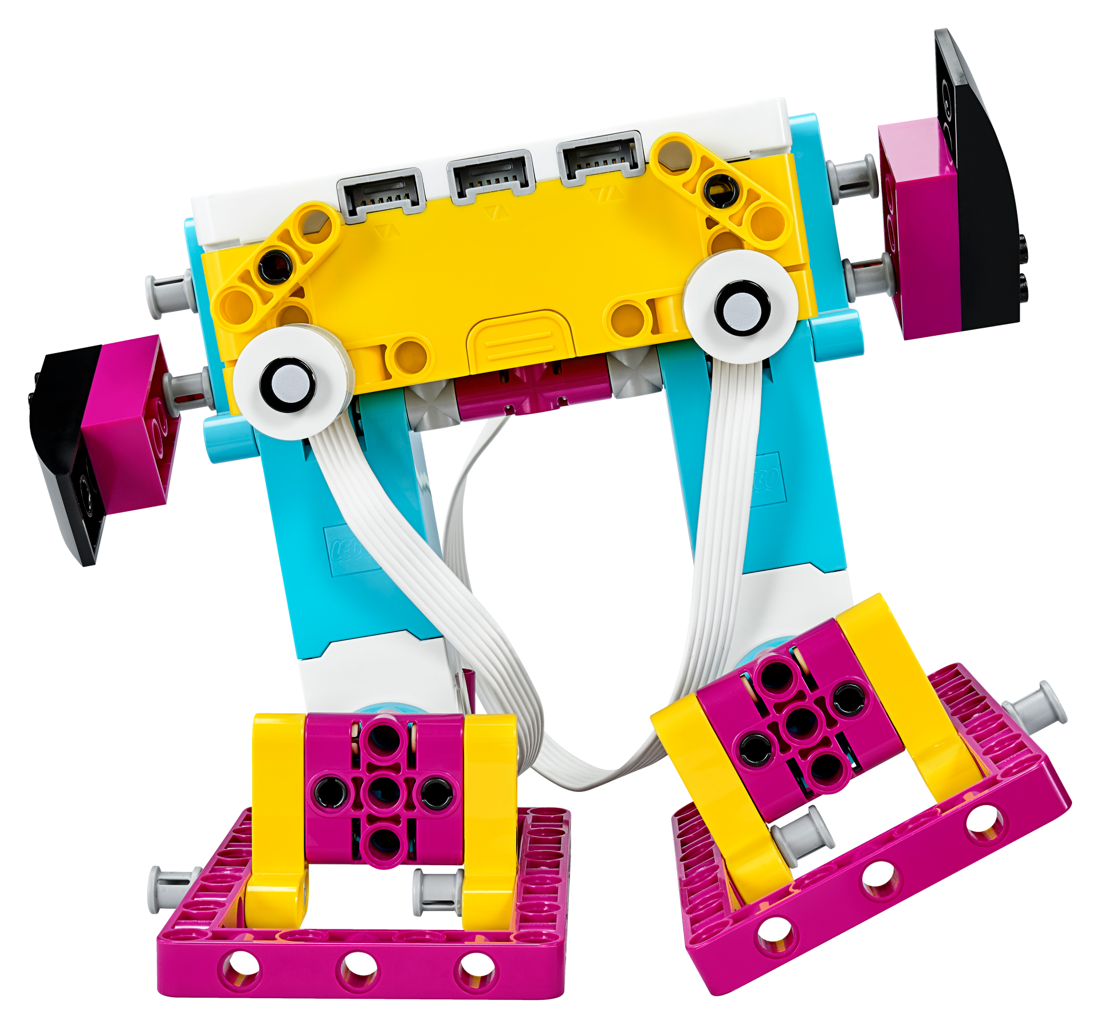
Summary and Questions
Notes:
Summary and Questions
Summarize the course and answer any remaining questions.
Check whether the objectives and expectations were met.
Remember to say/cover the following points:
Do you have any unanswered questions about anything we’ve covered today?
Go through the objectives of the training day again and check whether they were met.
Tip
If you have enough time, consider using the Teacher’s Kits for a final reflection activity:
Ask the participants to build a model that represents their two most important takeaways from today’s course.
Give them 3 minutes to build their models.
Ask the participants to share their models with the whole group, keeping it brief (especially with large groups, it’s a good idea to limit each person’s explanation to two sentences – one for each takeaway).

Slide 28
STEAM Progression for Your Classroom

Slide 29
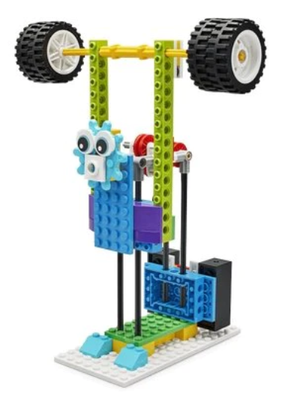
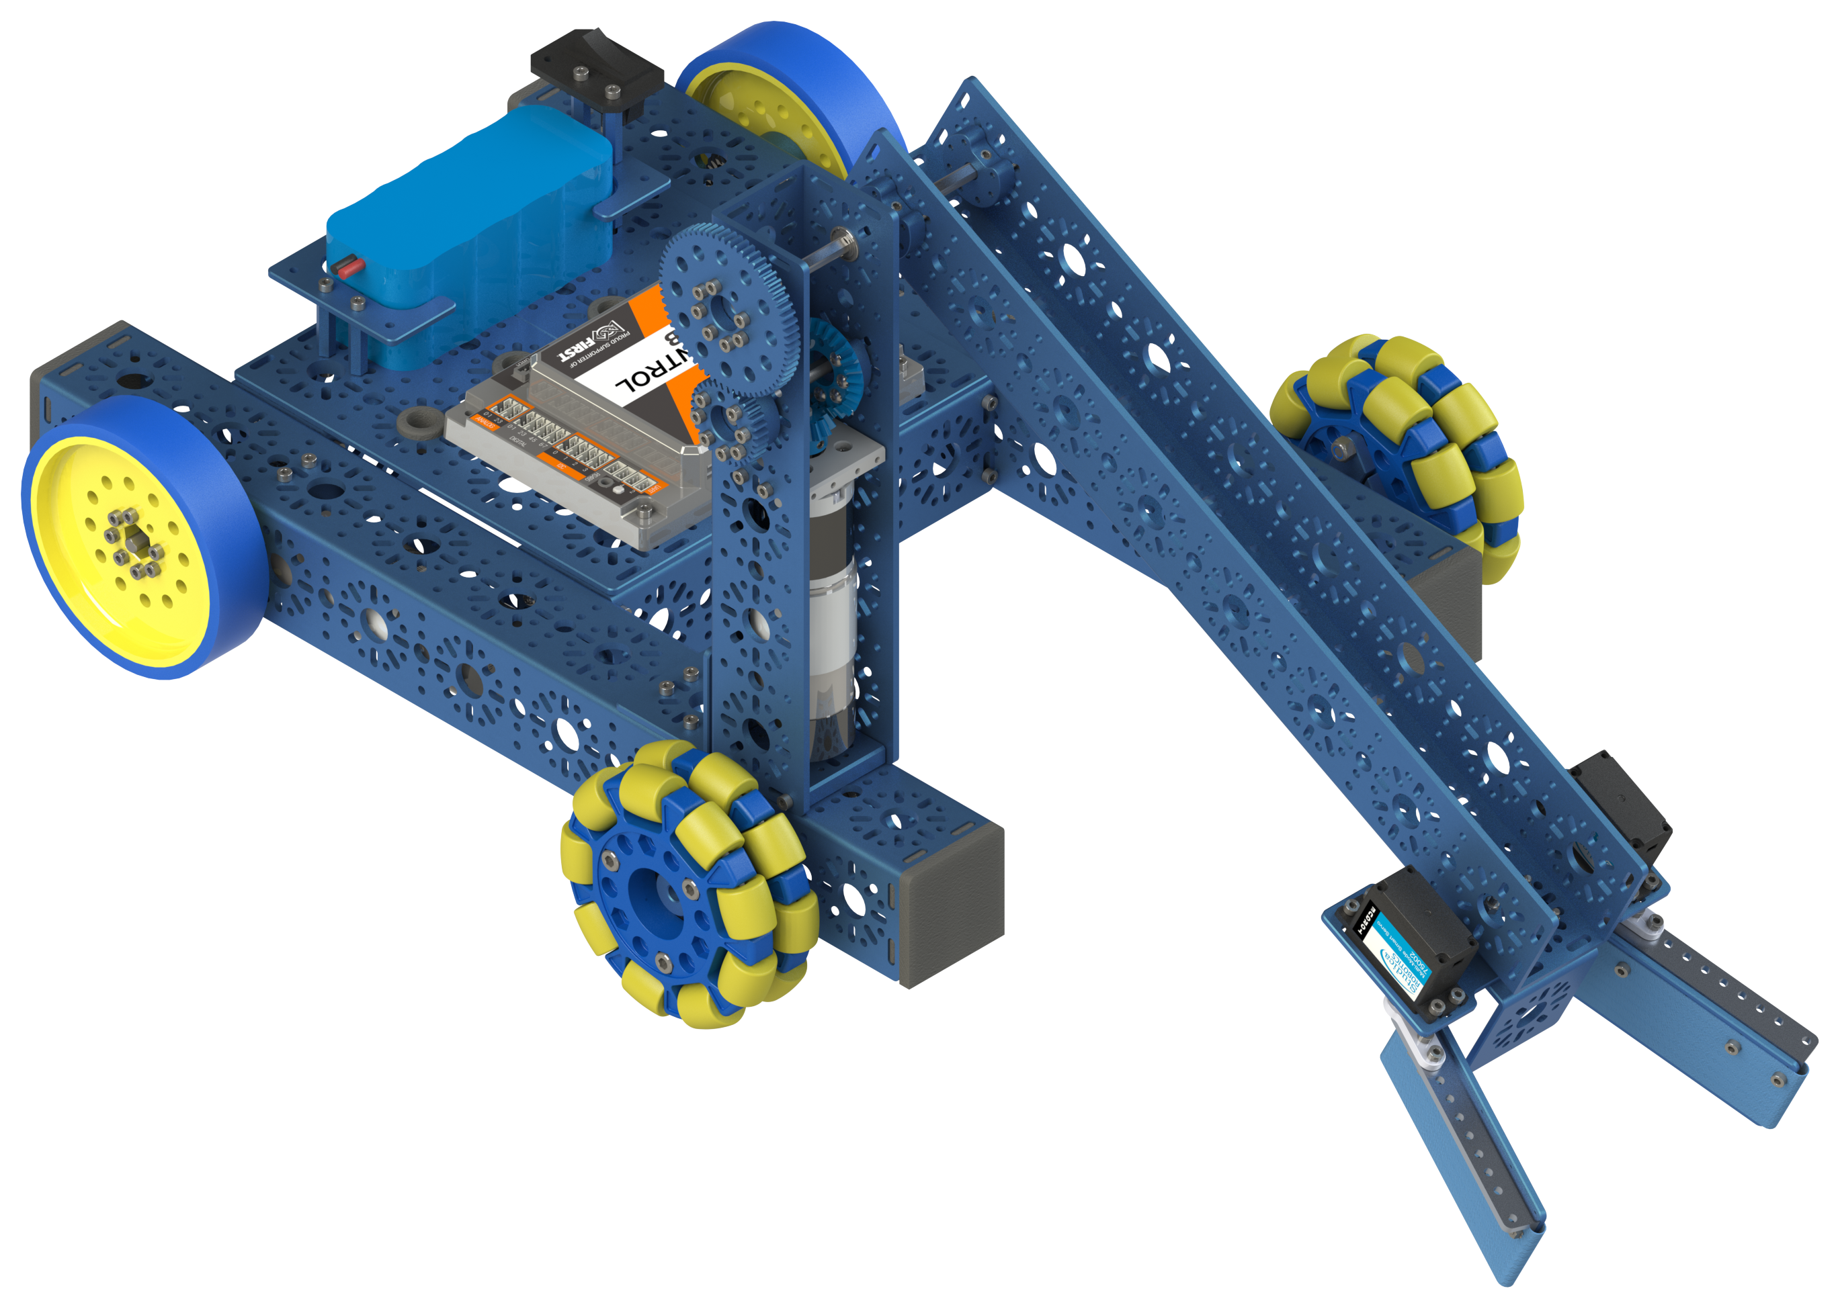
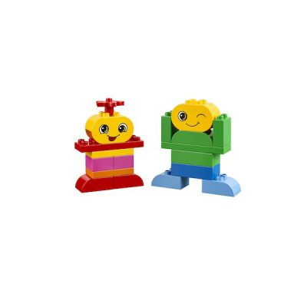
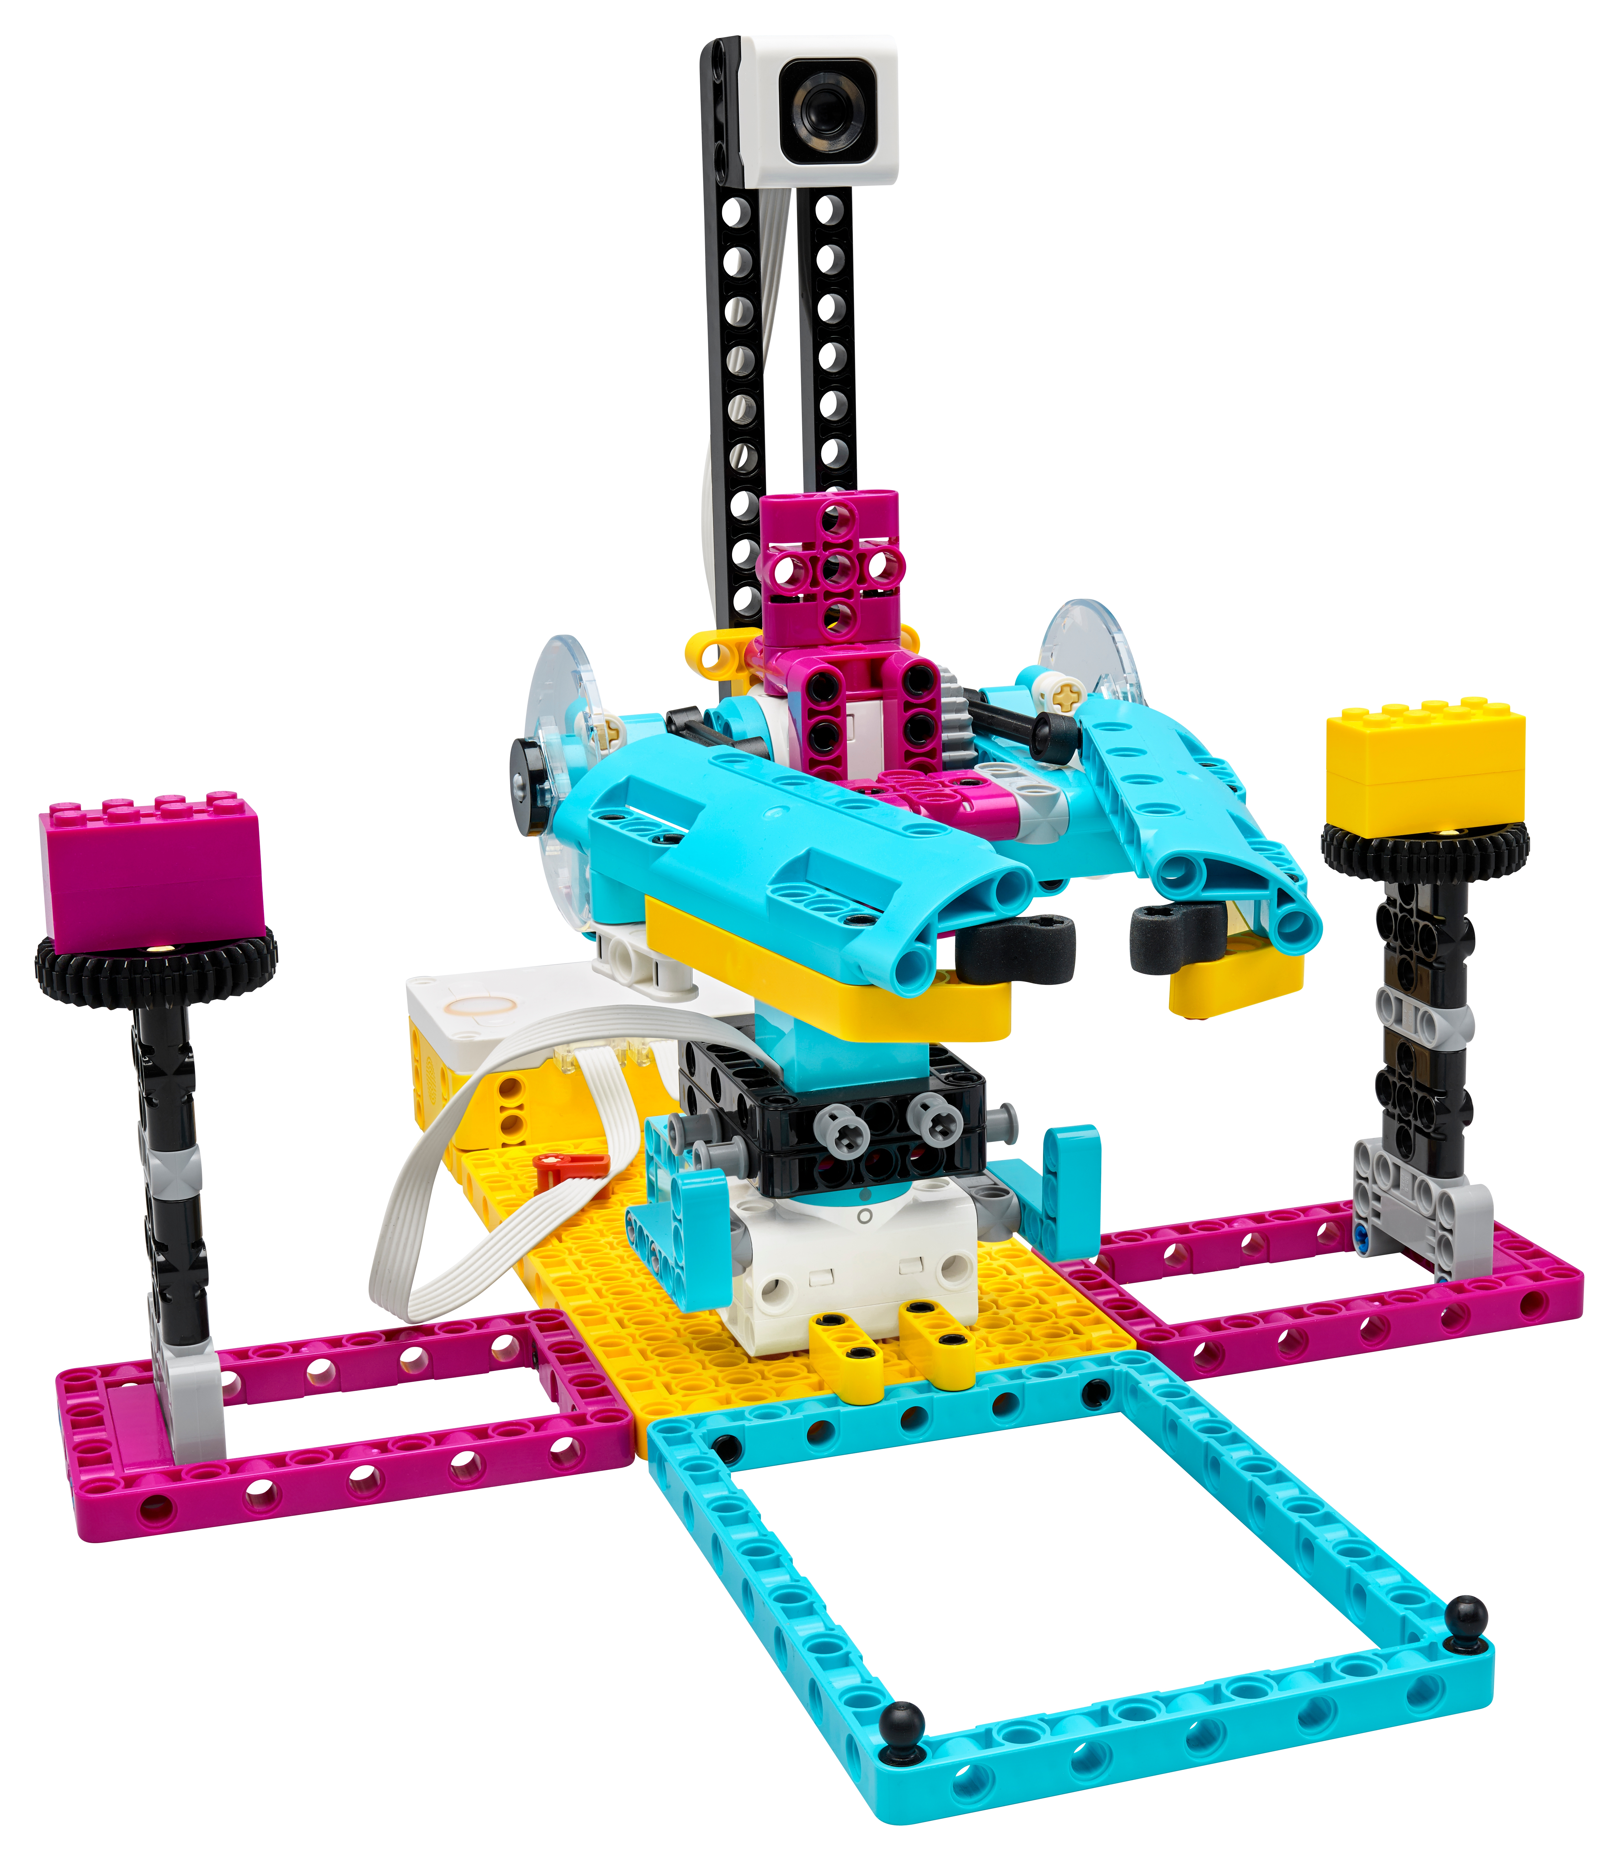
Resources and materials for everything from preschool through secondary school.
Resources and materials for everything from preschool through secondary school via the LEGO® Learning System combined with Studica and FIRST CANADA resources. Materials that work to deliver engaging, hands-on STEAM learning experiences for students of all ages.

Slide 30
KEY STRATEGIES
Cross-curricular
Range of subject-specific activities
Guided and open-ended activities
Support students at varying learning levels

Slide 31
LEARNING CONTINUUM
BRICQ MOTION ESSENTIAL
SPIKE ESSENTIAL
BRICQ MOTION PRIME
SPIKE PRIME
SPIKE PRIME
FTC CLASSROOM SET
STEAM PARK
CODING EXPRESS
EARLY LEARNING
GRADE 1-5
SECONDARY
GRADE 6 -8

Slide 32
EARLY LEARNING
GRADE 1-5
SECONDARY
GRADE 6 -8
HANDS ON STEAM
CODING CONCEPTS
ANALOG RESOURCES
HANDS ON STEAM
PHYSICAL SCIENCE
ANALOG AND DIGITAL RESOURCES
BASIC CODING CONCEPTS
HANDS ON STEAM
ANALOG AND DIGITAL RESOURCES
CODING AND STEAM CONCEPTS
OPEN ENDED STUDENT ACTIVITIES
ADVANCED CODING
MORE LANGUAGES
LARGER BUILD SYSTEM WITH MORE PARTS
MORE FABRICATION SKILLS
ADVANCED MECHANISMS

Slide 33
A Solution to the Hurdles of Hands-on STEM Education
A highly adaptable system meets every student wherever they are in their learning journey.
A progression of standards-aligned learning units, quality resources, intuitive hardware, and programming languages caters to students of all ages to develop essential skills like creativity and critical thinking.

Slide 34
Get in touch - We're here to help!
Quick Links to Studica Resources LEGO Education: https://www.studica.ca/en/lego-education-2
LEGO Education Teacher Resources: https://www.studica.ca/en/lego-education-resources
Studica Robotics Resources: https://docs.studica.com/en/latest/index.html

